Slide 1

REPORT FOR THE YEAR 2022 ON THE OPERATIONS OF MUNAITAS NWPC LLP
FOR THE PROVISION OF REGULATED SERVICES
Almaty, 2023

Slide 2
General information
On December 11, 2001, MunaiTas North-West Pipeline Company JSC was established.
Since January 2004, the company has been included in the State Register of Natural Monopoly Entities of the Republic of Kazakhstan.
On July 24, 2018, MunaiTas North-West Pipeline Company JSC was transformed into MunaiTas North-West Pipeline Company Limited Liability Partnership.
The Participants of the Partnership are:
KazTransOil JSC (51%);
CNPC Exploration and Development Company Ltd (49%).
KazTransOil JSC
CNPC Exploration and Development Company Ltd.
100%
CNPC (PRC)
100%
PRC Government
51%
MunaiTas NWPC LLP
49%
The Partnership does not have subsidiaries, branches and representative offices.
3

Slide 3
General information (continuation)
The core operation of the Partnership is the provision of oil transportation services via Kenkiyak-Atyrau trunk pipeline.
Kenkiyak-Atyrau trunk oil pipeline is designed to transport oil from the West Kazakhstan region of the republic in the western and eastern directions. The starting point for oil receiving and delivering of the trunk oil pipeline is the Kenkiyak MOPS in Kenkiyak village, and the final point is the OPS named after N.Shmanov in Atyrau city.
Since July 1, 2021, the possibility of oil transportation in the reverse direction has been realized – from Atyrau to Kenkiyak.
Parameters of Kenkiyak-Atyrau trunk oil pipeline
No. | Description | UoM | Quantity
1 | Length | km | 455,10
2 | Capacity | mln.t/year | 6,0
3 | Diameter | mm | 610
4 | Pipe wall thickness | mm | 7.1-12
5 | Pipe material | Х65 API 5L steel
6 | Maximum pressure | mPa | 6.4
The tariff for the provision of oil transportation services via Kenkiyak-Atyrau trunk pipeline
In 2011, ARNM Order No. 351-OD dated November 7, 2011 approved a specific tariff in the amount of 5,912 tenge per 1 ton per 1000 km with an introduction date being January 1, 2012.
By ARNM Order No. 8-OD dated January 19, 2012 on amendments to ARNM Order No. 351-OD dated November 7, 2011, the specific tariff of 5,912 tenge per 1 ton per 1000 km entered into force on April 1, 2012.
By Order of the DCRNM dated November 26, 2021 No. 132-OD, the tariff estimate was approved, taking into account the changes for the year 2021.
By Order of the DCRNM dated December 07, 2022 No. 157-OD, amendments were made to the Order of the DCRNM dated November 26, 2021 No. 132-OD on approval of the tariff estimate, taking into account the changes for the year 2021.

Slide 4
Investment program
By a joint order of the Ministry of Energy of the Republic of Kazakhstan dated April 29, 2016 and the CRNM dated April 14, 2016, the Investment Program of the Partnership for the years 2016-2020 was approved.
However, until 2018, due to the lack of confirmation of the resource base, the Participants of the Partnership did not make an investment decision on the implementation of the Reverse Project.
The project was approved by the Participant from the Chinese side only in May 2018. On the Kazakhstan side, the Reverse Project was approved by the decisions of the Investment Committees of KazTransOil JSC (minutes dated April 25, 2018), KazMunaiGas NC JSC (minutes dated June 12, 2018) and Samruk-Kazyna JSC (minutes dated July 10, 2018).
The Investment Program includes investments within the framework of the Reverse Project of Kenkiyak-Atyrau oil pipeline section up to 6 million tons per year within the framework of the Project “The Second stage of the second stage of Kazakhstan-China oil pipeline construction. Increase in capacity to 20 million tons/year” (hereinafter referred to as the Reverse Project) for a total amount of 22.5 billion tenge. At the same time, the actual costs for the implementation of the Reverse Project in the period from 2016 to 2022 amounted to 29.1 billion tenge.
The main condition for the implementation of the Reverse Project is the provision of a resource base – the availability of long-term volumes of West Kazakhstan oil for transportation to domestic oil refineries and for export to PRC.
It shall be noted that the approved tariff of 2011 does not take into account and could not objectively take into account the costs of implementing the approved investment program for 2016-2020, as a result of which the implementation of this investment program is at the expense of profits and depreciation charges of the Partnership.
The Partnership does not have a new investment program, however, in accordance with the instructions of the Head of State and concerned government agencies, the Partnership is working on the issue of implementing a project to expand Kenkiyak-Atyrau oil pipeline to 12 million tons per year.
The Expansion Project is planned to be implemented, among other things, at the expense of the Partnership’s own funds. In this regard, in order to implement the Expansion Project, the Partnership accumulates funds generated by the accumulation of depreciation charges.

Slide 5
Investment program (continuation)
The purpose of the Reverse Project implementation is to achieve oil transportation in the reverse direction in the amount of up to 6 million tons per year through Kenkiyak-Atyrau trunk oil pipeline to ensure the supply of West Kazakhstan oil to the republic’s oil refineries and to increase oil exports to PRC. Due to the decrease in production volumes at Aktobe and Kumkol fields, it is necessary to reverse oil supplies from the western region in order to provide West Kazakhstan oil to the oil refineries of the Republic of Kazakhstan, which will create conditions for providing the domestic market of the Republic with petroleum products.
The basis for the implementation of the Reverse Project is the Agreement between the Government of the Republic of Kazakhstan and the Government of the People’s Republic of China on certain Issues of cooperation in the development and Operation of Kazakhstan-China oil pipeline, ratified by the Law of the Republic of Kazakhstan dated October 17, 2013 No. 136-V, according to which the parties shall increase the capacity of Kazakhstan-China oil pipeline sections in accordance with reasonable volumes of oil supplies to the domestic market and for export.
The current status of the Reverse Project.
To date, all activities have been completed and the following is put into operation:
the 1st start-up complex (EPC-1 facilities), the act of acceptance of facilities into operation was signed on June 15, 2020;
the 2nd start-up complex (facilities of technological purpose of Aman OPS), the act of acceptance of facilities into operation was signed on June 30, 2021;
the facilities of the heating furnaces, the act of acceptance of the facilities into operation was signed on October 29, 2021;
the facilities of the supplying gas pipeline (EPC-4), the act of acceptance of facilities into operation was signed on November 30, 2022.
Since July 1, 2021, it has been possible to transport oil in the reverse direction through the technological facilities of Aman OPS.
All equipment is operating normally.
Facilities of the 3rd start-up complex (administrative facilities) remain in work, which do not affect oil transportation.

Slide 6
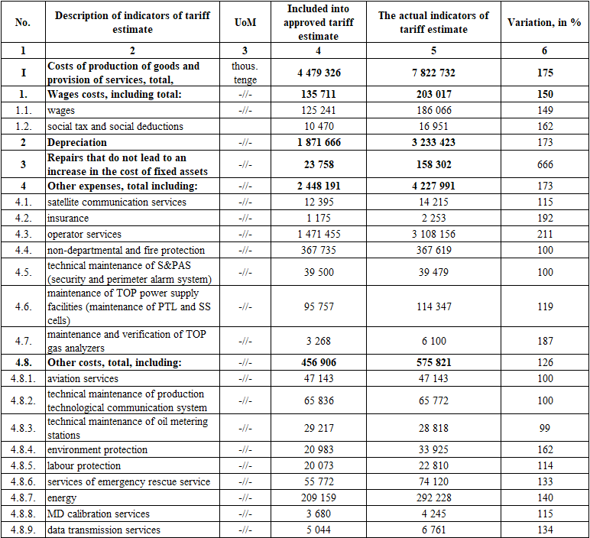
Execution of the tariff estimate for the year 2022
(net cost)
In fact, in 2022, there are no outstanding cost items at net cost by more than 5 percent of the amounts provided for in the approved tariff estimates.

Slide 7
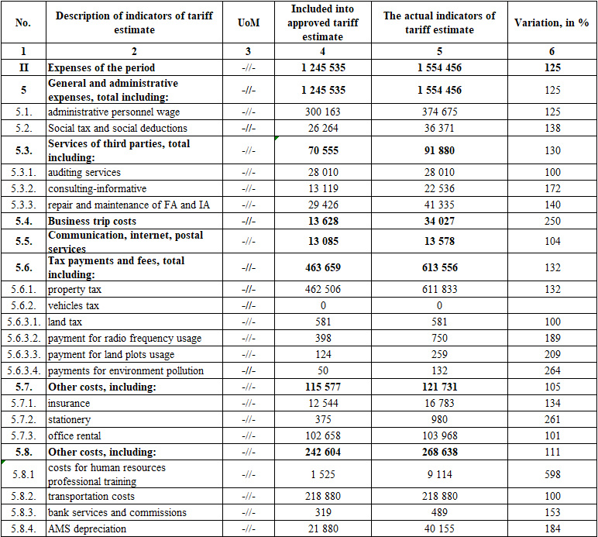
Execution of the tariff estimate for the year 2022
(expenses of the period)
In fact, in 2022, there are no outstanding cost items for the expenses of the period by more than 5 percent of the amounts provided for in the approved tariff estimates.

Slide 8
Financial-economic indicators of the operations for the year 2022
Reduced balance sheet
Reduced income and expense statement
Indicators, bln tenge | For the year 2022
ASSETS in total, including: | 65,3
Short-term assets | 15,6
Long-term assets | 49,7
LIABILITIES in total, including: | 65,3
Short-term liabilities | 3,00
Long-term liabilities | 8,3
Capital | 54,0
Indicators, bln tenge | For the year 2022
INCOME in total, including: | 15,1
income from core operations | 13,4
income from financing | 1,6
other income | 0,1
EXPENSES in total, including: | 12,7
net cost | 9,1
administrative expenses | 1,7
financing expenses | 0,3
other expenses | 0,9
Corporate income tax | 0,7
Total profit | 2,4
Financial and economic indicators are reflected in detail in the financial statements of the Partnership for the first half of the year 2022. The financial statements of the Partnership have been prepared in accordance with International Financial Reporting Standards and confirmed by the audit report of an independent auditor.

Slide 9
Information about the volume of services provided
During the reporting period, 5 612 thousand tons of oil were transported, including:
1 187 thousand tons for export;
4 426 thousand tons for the domestic market.
Thus, the ratio is 78.85% for the domestic market and 21.15% for exports.
In the reporting period, 26 shipping companies used the services of the Partnership for oil transportation. The largest share of the transported oil belongs to:
Mangistaumunaigas JSC – 41.42%;
Embamunaigas JSC – 23.55%;
CNPC-Aktobemunaigas JSC – 8.61%;
KoZhan JSC – 5.02%;
Sagiz Petroleum Company LLP – 3.37%;
KMK Munai JSC – 2.06%;
Maten Petroleum LLP – 1.99%.
CARGO TURNOVER
Export | mln.tn/km | 451,82
Internal market | mln.tn/km | 1 814,53
TOTAL CARGO TURNOVER | mln.tn/km | 2 266,34
INCOME
Export | bln.tenge | 2,7
Internal market | bln.tenge | 10,7
TOTAL INCOME | bln.tenge | 13,4

Slide 10
Working with consumers
The main work with consumers of regulated services is to provide shippers with an equal opportunity to transport oil through Kenkiyak-Atyrau trunk oil pipeline, in accordance with the concluded agreements.
The quality of the services provided is ensured :
using modern methods in the work of measuring the amount of oil (OMS is a mass method, i.e. keeping records of oil by mass, not by volume);
non-departmental security of the trunk oil pipeline facilities;
operational control over the operation of the oil pipeline (SCADA system, S&PAS);
periodic diagnostics of the trunk oil pipeline facilities, which makes it possible to determine the spatial position of the pipeline with reference to the coordinates of the detected defects with an accuracy of 0.5 meters.

Slide 11
Tasks for the year 2023
1
Ensuring safe and uninterrupted transportation of oil through Kenkiyak-Atyrau trunk oil pipeline;
2
Completion of the Reverse Project facilities construction;
3
Approval of the investment program for 5 years;
4
Approval of tariff for 5 years period.

Slide 12
Thanks for attention!

