Slide 1
REPORT FOR THE 1st HALF OF THE YEAR 2022 ON THE OPERATIONS OF MUNAITAS NWPC LLP FOR THE PROVISION OF REGULATED SERVICES
Almaty, 2022

Slide 2
General information
On December 11, 2001, MunaiTas North-West Pipeline Company JSC was established.
Since January 2004, the company has been included in the State Register of Natural Monopoly Entities of the Republic of Kazakhstan.
On July 24, 2018, MunaiTas North-West Pipeline Company JSC was transformed into MunaiTas North-West Pipeline Company Limited Liability Partnership.
The Participants of the Partnership are:
KazTransOil JSC (51%);
CNPC Exploration and Development Company Ltd (49%).
KazTransOil JSC
CNPC Exploration and Development Company Ltd.
100%
CNPC (PRC)
100%
PRC Government
51%
MunaiTas NWPC LLP
49%
The Partnership does not have subsidiaries.
3

Slide 3
General information (continuation)
The core operation of the Partnership is the provision of oil transportation services via Kenkiyak-Atyrau trunk pipeline.
Kenkiyak-Atyrau trunk oil pipeline is designed to transport oil from the West Kazakhstan region of the republic in the western and eastern directions. The starting point for oil receiving and delivering of the trunk oil pipeline is the Kenkiyak MOPS in Kenkiyak village, and the final point is the OPS named after N.Shmanov in Atyrau city.
Since July 1, 2021, the possibility of oil transportation in the reverse direction has been realized – from Atyrau to Kenkiyak.
Parameters of Kenkiyak-Atyrau trunk oil pipeline
No. | Description | UoM | Quantity
1 | Length | km | 455,10
2 | Capacity | mln.t/year | 6,0
3 | Diameter | mm | 610
4 | Pipe wall thickness | mm | 7.1-12
5 | Pipe material | Х65 API 5L steel
6 | Maximum pressure | mPa | 6.4
The tariff for the provision of oil transportation services via Kenkiyak-Atyrau trunk pipeline
In 2011, ARNM Order No. 351-OD dated November 7, 2011 approved a specific tariff in the amount of 5,912 tenge per 1 ton per 1000 km with an introduction date being January 1, 2012.
By ARNM Order No. 8-OD dated January 19, 2012 on amendments to ARNM Order No. 351-OD dated November 7, 2011, the specific tariff of 5,912 tenge per 1 ton per 1000 km entered into force on April 1, 2012.
By Order of the DCRNM dated November 26, 2021 No. 132-OD, the tariff estimate was approved, taking into account the changes for the year 2021.

Slide 4
Investment program
By a joint order of the Ministry of Energy of the Republic of Kazakhstan dated April 29, 2016 and the CRNM dated April 14, 2016, the Partnership’s Investment Program for 2016-2020 was approved.
The Investment Program includes investments within the framework of the Reverse Project of Kenkiyak-Atyrau oil pipeline section up to 6 million tons per year within the framework of the Project “Second phase of the second stage of construction of Kazakhstan-China oil pipeline. Increase in productivity to 20 million tons/year" (hereinafter referred to as the Reverse Project) for a total amount of 22.5 billion tenge.
The main condition for the implementation of the Reverse Project is the provision of a resource base - the availability of long-term volumes of West Kazakhstan oil for transportation to domestic oil refineries and for export to China.
However, until 2018, due to the lack of confirmation of the resource base, the Participants of the Partnership did not make an investment decision on the implementation of the Reverse Project.
The project was approved by the Participant from the Chinese side only in May 2018. On the Kazakhstan side, the Reverse Project was approved by the decisions of the Investment Committees of KazTransOil JSC (minutes dated April 25, 2018), KazMunaiGas NCJSC (minutes dated June 12, 2018) and Samruk-Kazyna JSC (minutes dated July 10, 2018).
It shall be noted that the approved tariff of 2011 does not take into account and could not objectively take into account the costs of implementing the approved investment program for 2016-2020, as a result of which the implementation of this investment program is at the expense of profits and depreciation charges of the Partnership.
The Partnership does not have a new investment program approved by the authorized and state agencies for 2022. The Partnership is currently completing the implementation of the previously approved Reverse Project. In fact, as of the 1st half of 2022, the Partnership allocated funds for capital investments from the Partnership’s profits and depreciation charges to complete the Reverse Project.
 | Year 2016 | Year 2017 | Year 2018 | Year 2019 | Year 2020 | Year 2021 | 1st half of the year 2022
Plan | 5 798,3 | 4 975,7 | 8 136,4 | 1 632,1 | 1 993,4 | 0,0 | 0,0
Actual | 0,0 | 0,0 | 1 861,2 | 8 413,2 | 9 945,6 | 6 062 | 740

Slide 5
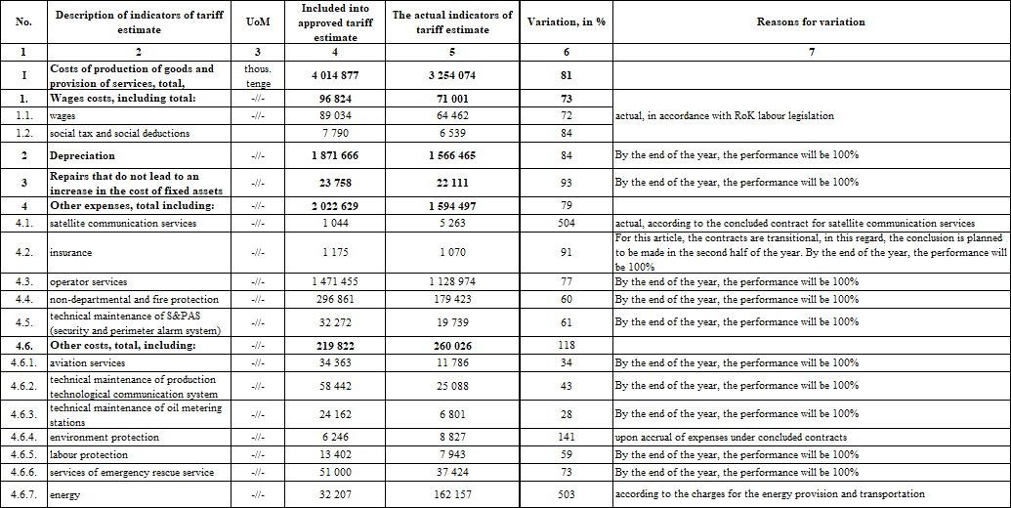
Execution of the tariff estimate for the 1st half of 2022
(net cost)

Slide 6
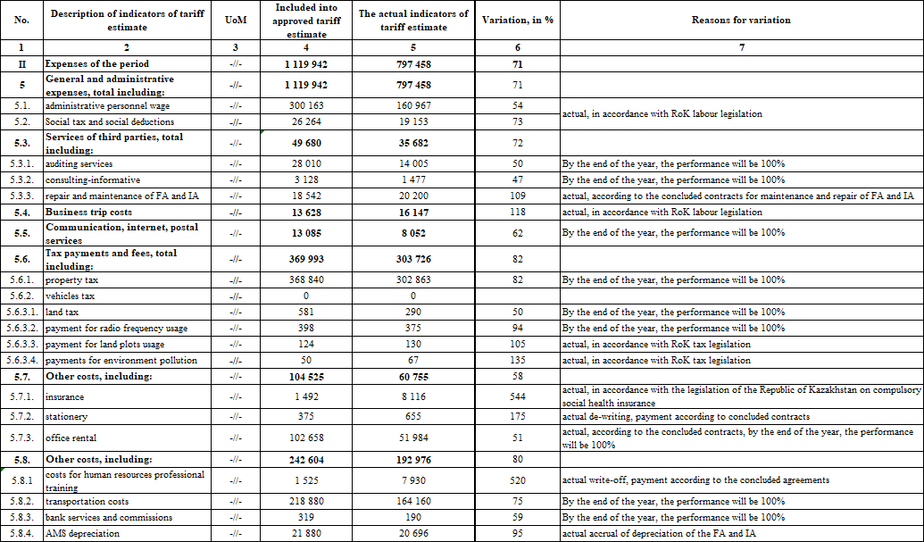
Execution of the tariff estimate for the 1st half of 2022
(expenses of the period)

Slide 7
Financial-economic indicators of the operations for the 1st half of the year 2022
Reduced balance sheet
Reduced income and expense statement
Indicators, mln tenge | For the 1st half of the year 2022
ASSETS in total, including: | 65 699
Short-term assets | 17 423
Long-term assets | 48 276
LIABILITIES in total, including: | 65 699
Short-term liabilities | 3 663
Long-term liabilities | 10 224
Capital | 51 813
Indicators, mln tenge | For the 1st half of the year 2022
INCOME in total, including: | 8 949
income from core operations | 6 524
income from financing | 887
other income | 1 538
EXPENSES in total, including: | 5 975
net cost | 5 030
administrative expenses | 671
financing expenses | 259
other expenses | 15
Corporate income tax | 590
Total profit | 2 383
Financial and economic indicators are reflected in detail in the interim financial statements of the Partnership for the first half of the year 2022. The financial statements of the Partnership have been prepared in accordance with International Financial Reporting Standards.

Slide 8
Information about the volume of services provided
During the reporting period, 2 735 thousand tons of oil were transported, including:
581 thousand tons for export;
2 154 thousand tons for the domestic market.
Thus, the ratio is 78.78% for the domestic market and 17.4% for exports.
In the reporting period, 26 shipping companies used the services of the Partnership for oil transportation. The largest share of the transported oil belongs to:
Mangistaumunaigas JSC – 41.1%;
Embamunaigas JSC – 25.6%;
KoZhan JSC – 7.2%;
CNPC-Aktobemunaigas JSC – 4.1%;
Sagiz Petroleum Company LLP – 3.4%;
Kazakhoil Aktobe LLP – 2.3%;
Maten Petroleum LLP – 2.1%.
CARGO TURNOVER
Export | mln.tn/km | 168,4
Internal market | mln.tn/km | 890,8
TOTAL CARGO TURNOVER | mln.tn/km | 1 059,2
INCOME
Export | bln.tenge | 996
Internal market | bln.tenge | 5 266
TOTAL INCOME | bln.tenge | 6 262

Slide 9
Working with consumers
The main work with consumers of regulated services is to provide shippers with an equal opportunity to transport oil through Kenkiyak-Atyrau trunk oil pipeline, in accordance with the concluded agreements.
The quality of the services provided is ensured by:
using modern methods in the work of measuring the amount of oil (OMS is a mass method, i.e. keeping records of oil by mass, not by volume);
non-departmental security of the trunk oil pipeline facilities;
operational control over the operation of the oil pipeline (SCADA system, S&PAS);
periodic diagnostics of the trunk oil pipeline facilities, which makes it possible to determine the spatial position of the pipeline with reference to the coordinates of the detected defects with an accuracy of 0.5 meters.

Slide 10
Tasks for the year 2022
1
Ensuring safe and uninterrupted transportation of oil through Kenkiyak-Atyrau trunk oil pipeline;
2
Completion of the Reverse Project facilities construction.

Slide 11
Thanks for attention!

